Slide 1

Crowd Count

Slide 2
Purpose of the crowd count
The primary objective of the Crowd Count system is to automatically estimate the number of people in a given area using visual data (images or video feeds) and to generate actionable insights for effective crowd management. This system is designed to support real-time monitoring, spatial analysis, and trend visualization, enabling proactive decision-making in dynamic environments.

Slide 3
Tools & Technologies
Backend & Server Technologies
S.No | Component | Technology/Library | Role in the Project
1. | Web Framework | Flask | The core Python web server that handles routing, HTTP requests/responses, and ties all components together.
2. | Authentication & DB | Pyrebase (Firebase) | Used for user authentication (sign-in/register) and Realtime Database interaction (storing user data, logs, and camera config).
3. | Authentication/Security | PyJWT (JWT) | Generates and verifies Server-side JSON Web Tokens (server_jwt) for secure user session management.

Slide 4
4. | Data Structure/Utility | csv, io, os, queue, threading, datetime | Python standard libraries for CSV file generation for history download, filesystem operations, multithreading for video analysis, and time management.
5. | Data Visualization | Matplotlib (matplotlib.pyplot, mdates) | Generates the historical crowd count and live density charts (saved to a buffer as a PNG image).

Slide 5
2) Crowd Counting & Video Processing
# | Component | Technology/Library | Role in the Project
6. | Object Detection Model | YOLOv8 (from Ultralytics) | The core Deep Learning model used to identify and locate every 'person' (person_class_id = 0) within each video frame.
7. | Video/Image Processing | OpenCV (cv2) | Used for reading video streams (from webcam/file), drawing bounding boxes and the Area of Interest (AOI) line, and encoding frames for the web video feed.
8. | Tracking Algorithm | Custom Logic (using OBJECT_TRACKER) | Manages object tracking across frames to ensure the same person isn't counted multiple times and to check if an object crosses the AOI line (using distance calculation).
9. | Video Streaming | Multipart/x-mixed-replace | The HTTP protocol used to serve the continuous, real-time video feed to the browser via the /video_feed/<area_name> route.

Slide 6
3) Frontend (User Interface)
# | Component | Technology/Library | Role in the Project
10. | Structure | HTML | Defines the structure and content of all web pages (e.g., signin.html, home.html, vid_analy.html).
11. | Styling | CSS | Controls the presentation, layout, and visual design of the application.
12. | Client-side Logic | JavaScript (JS) | Handles client-server interaction (like AJAX calls to update live counts and charts), user interaction, and potentially rendering the live video feed.

Slide 7
Where It Can Be Implemented ?
Retail & Commercial Spaces: Monitor foot traffic in malls, queues at checkout, and hot zones in large stores for business intelligence and layout optimization.
Transportation Hubs: Manage congestion at airport security, boarding gates, and railway platforms to ensure safety and smooth passenger flow.
Events & Public Safety: Enforce strict occupancy limits (using your capacityThreshold) at stadiums, concerts, and festivals to prevent overcrowding and manage emergency evacuations.
Institutional & Corporate Campuses: Track usage of common areas (libraries, cafeterias) and monitor access to restricted industrial zones for safety and resource allocation.
Smart Cities: Collect data on pedestrian movement in public squares and on sidewalks for urban planning and infrastructure development.

Slide 8
Problem Addressed & How Your Project Solves It
1. 🚨 Exceeding Capacity and Safety Thresholds
Problem: Manual monitoring (or simple security cameras) is too slow and unreliable to prevent dangerous overcrowding when the number of people rapidly approaches or exceeds a predefined safety limit.
Solution: The system provides Real-Time Crowd Monitoring with a definitive count. Crucially, it generates an immediate, proactive alert once the established threshold is crossed, allowing staff to swiftly stop entries or redirect traffic, thus preventing safety hazards and regulatory violations.
2. 👀 Lack of Real-Time Crowd Visibility for Users
Problem: Users, customers, or employees often waste time by going to a location (like a store, cafeteria, or gym) only to find it uncomfortably crowded or full.
Solution: The system enables User Crowd Status Viewing. Authorized users can check the current crowd count and density status of an area (e.g., via a dashboard or app) before physically arriving. This improves the customer experience by helping them choose less busy times or locations.
3. 🛡️ Ineffective Management Oversight
Problem: Security or operations managers, particularly those overseeing multiple sites or zones (like an Admin viewing multiple user areas), lack a centralized, instantaneous way to confirm current conditions across all monitored spaces.
Solution: The Admin View and centralized dashboard allow supervisors to remotely monitor live counts and quickly verify the active status of multiple zones, improving security response times and overall operational control.

Slide 9
Future Enhancements
1. Behavioral Anomaly Detection
What it is: Moving beyond counting to contextual monitoring.
Mechanism: Analyze the tracked object data (speed, location, duration) to automatically detect unusual or risky patterns.
Examples: Flagging loitering (person stationary for too long) or sudden crowd scattering (potential panic/incident).
Value: Upgrades the system to provide proactive security intelligence.
2. Mobile Notifications (Push/SMS)
What it is: Ensuring critical alerts are received instantly, anywhere.
Mechanism: Integrate with services like FCM (Firebase Cloud Messaging) for push notifications or Twilio/Vonage for SMS. The server sends the alert payload directly to the registered mobile devices.
Value: Guarantees immediate response to capacity breaches, even when personnel are away from the dashboard.
3. User Role-Based Data Filtering
What it is: Implementing security and privacy controls over data access.
Mechanism: Define roles and permissions (e.g., Admin, Manager_Cafeteria) in the application logic. Restrict each user's view to only the camera feeds, settings, and historical logs relevant to their role.
Value: Enhances security and creates a clear, customized experience by preventing information overload for non-admin users.

Slide 10
4. Hardware Acceleration (GPU/NPU Optimization)
What it is: Boosting the speed and capacity of the video analysis engine.
Mechanism: Configure the YOLO model to utilize specialized hardware like NVIDIA GPUs (CUDA) or Jetson NPUs. This involves code optimization and specialized hardware deployment.
Value: Achieves a significantly higher Frame Rate (FPS), allowing the system to monitor more high-resolution cameras simultaneously with better performance.
5. Adding Camera by IP Address (RTSP/HTTP Stream)
What it is: Allowing seamless integration of professional security cameras.
Mechanism: Update the camera configuration to accept a full RTSP or HTTP stream URL. This URL is then passed directly to cv2.VideoCapture() in the backend.
Value: Essential for real-world deployment, enabling the system to monitor permanent, installed IP surveillance cameras.

Slide 11
Understanding of Modules
Milestone 1: Login , Registration page, Dashboard,Security & JWT implementation of jwt for user login created in M1
Milestone 2: Detecting, People count & Edit Zones-in webcam,video and image
1.FE,BE,DB-login,registraion,dashboard of M1
2.JWT-Login authentication
3.Video Feed and Zone Management
4.Connect to webcam/IP camera.
5.Draw and save zones on video feed(selecting the zone & drwaing the line).
6.Preview and edit zones7.Count people for Images,Videos,Live Webcam
Milestone 3: LIVE Dashboard-understanding the requirements & steps to implement libraries & the connect to the project
1. 1st map/chart is about people count.
what are the inputs ?(live video captured at main entrance,retail area,food court) what is the expected output ?(plot to give the crowd count) how to implement? -line plot
2. 2nd map/chart is about density that you can understand in one glance heatmap or scatterplot
3.bar plot can be used for zone occupancy. People Count.
4.Alert System/Notifications when the ppl count is exceeding the threshold set(threshold can be given dynamically/static within the code)

Slide 12
Libraries to Be Installed
Category | Library | Command | Purpose
Deep Learning | ultralytics | pip install ultralytics | Provides the YOLOv8 model for object detection and tracking.
Video Processing | opencv-python | pip install opencv-python | Handles video stream capture, frame processing, and drawing annotations.
Web Framework | Flask | pip install Flask | The core Python web server to run your dashboard and APIs.
Cloud Integration | Pyrebase | pip install Pyrebase4 | Manages connections to Firebase Realtime Database and Authentication.
Security | PyJWT | pip install PyJWT | Used for generating and verifying secure JSON Web Tokens (sessions).
Data Handling | numpy | pip install numpy | Essential for array operations and mathematical calculations (distances, etc.).
Visualization | matplotlib | pip install matplotlib | Used to generate charts and graphs for historical data and density trends.

Slide 13
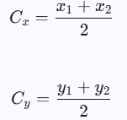

Mathematics & Formulas Behind
1. Bounding Box Center (Centroid)
This calculation localizes the center point of the detected object for tracking.
Formula | Python Code Snippet
 | # ... where get_bbox_center is defined as: def get_bbox_center(x1, y1, x2, y2): return int((x1 + x2) / 2), int((y1 + y2) / 2) center_x, center_y = get_bbox_center(x_1, y_1, x_2, y_2)
2. Euclidean Distance (Object Tracking)
Used to measure the distance between the current detection and previously tracked objects to assign a consistent ID.
Formula | Python Code Snippet
 | dist = np.sqrt((center_x - prev_x)**2 + (center_y-prev_y)**2) if dist < min_dist and dist < 100: # ... matching logic ...

Slide 14

3. Area of Interest (AOI) Line Check
Used to determine if the object's centroid is counted (i.e., below the defined line).
Formula | Python Code Snippet
Line Parameters (m and b): | def is_in_aoi_below_line(center_x, center_y, line_coords): # Unpack the line coordinates from the list/tuple x1, y1, x2, y2 = line_coords # Error check for vertical line (x1 == x2) # The original code skipped this, but proper implementation requires it. if x1 == x2: return False # Cannot calculate slope; assume outside or handle as error # 1. Calculate the slope (m) of the line m = (y2 - y1) / (x2 - x1) # 2. Calculate the y-intercept (b) of the line (using y = mx + b) b = y1 - m * x1 # 3. Check if the object's center_y is below the line (i.e., inside the AOI) # The condition center_y > (m * center_x + b) implies "below the line" return center_y > m * center_x + b

Slide 15
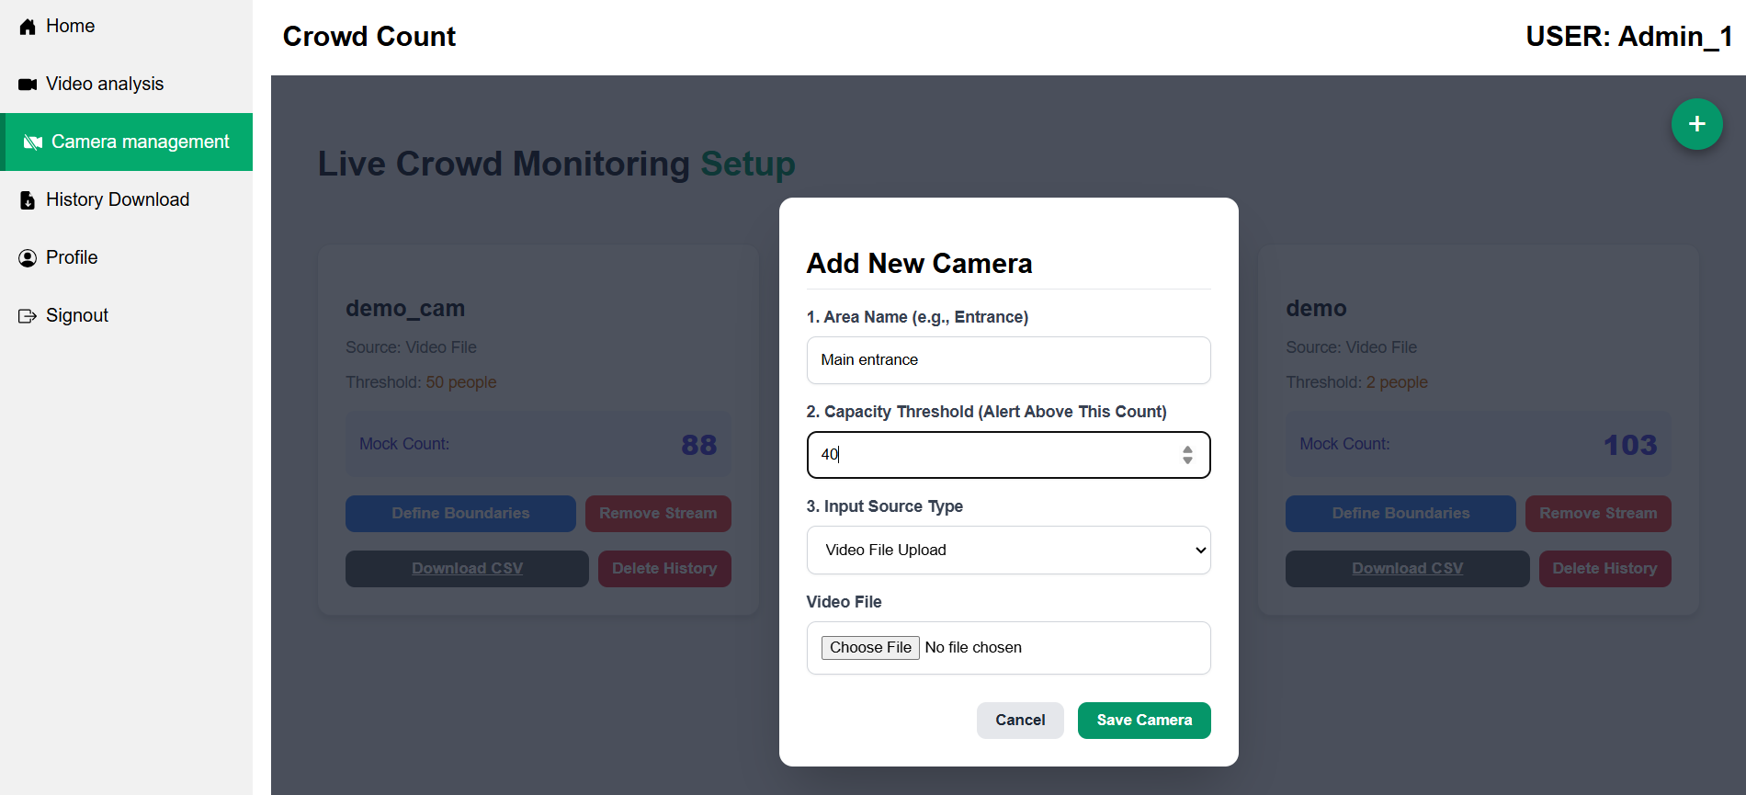
Coding Details
Load video using OpenCV
To add a new camera, a user must complete the following steps on the form:
Specify the Area Name (e.g., "Main entrance").
Set the Capacity Threshold (the count above which an alert is triggered, currently 40).
Select the Input Source Type (e.g., "Video File Upload").
Provide the corresponding video source details (e.g., upload the Video File if "Video File Upload" is selected).
Click the "Save Camera" button to submit the new camera configuration.

Slide 16
What's going on backend :
@app.route('/upload_video', methods=['POST'])
def upload_video():
logged_in_uid = get_logged_in_uid(request)
if not logged_in_uid: return jsonify({"error": "Unauthorized"}), 401
# Only Admins can use this page
if not is_user_admin(logged_in_uid): return jsonify({"error": "Access Denied"}), 403
if "video" not in request.files:
return jsonify({"error": "No file"}), 400
video_file = request.files["video"]
area_name = request.form.get("areaName", "Unknown")
threshold = int(request.form.get("capacityThreshold", 0))
if get_stream_info(logged_in_uid, area_name):
return jsonify({"message": "Stream active. Stop first."}), 409
path = os.path.join(UPLOAD_FOLDER, secure_filename(video_file.filename))
video_file.save(path)
if not os.path.exists(path):
return jsonify({"error": "Save failed"}), 500
start_stream_thread(logged_in_uid, area_name, path, threshold)
return jsonify({"message": f"Processing started for {area_name}."}), 200

Slide 17
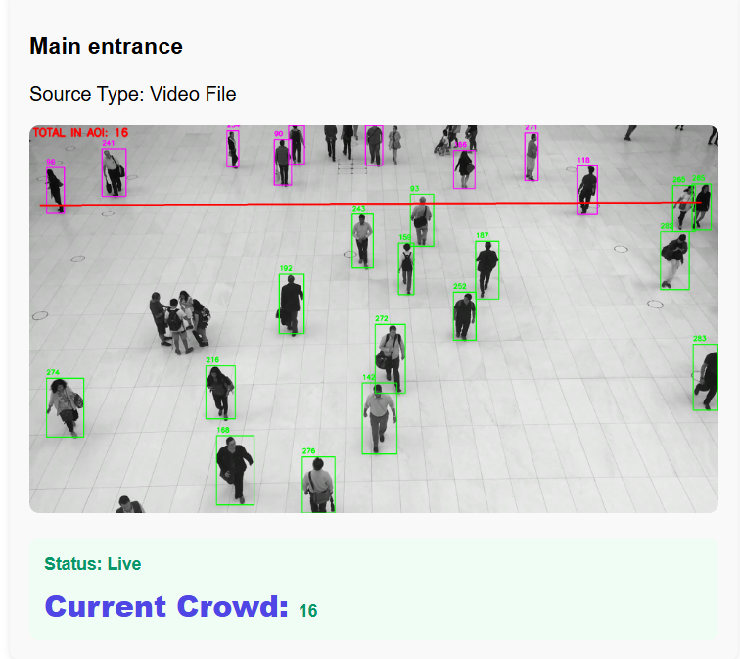
Run YOLO model to detect objects
The image displays a crowd counting system dashboard for the "Main entrance.“
The system detects people using bounding boxes: green boxes for general detection, and magenta/pink boxes for people near or across the red horizontal line, which defines the Area of Interest (AOI).
The system confirms the Current Crowd count is 16, which is the total number of people detected within the AOI. The input source is a Video File, but the analysis Status is Live.

Slide 18
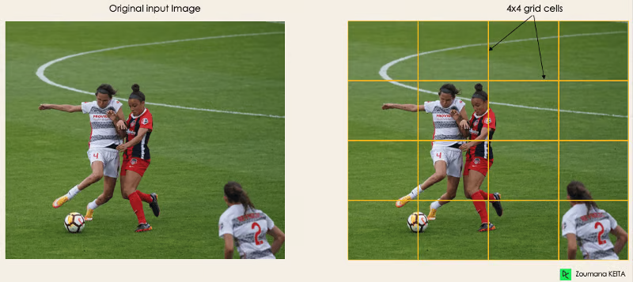
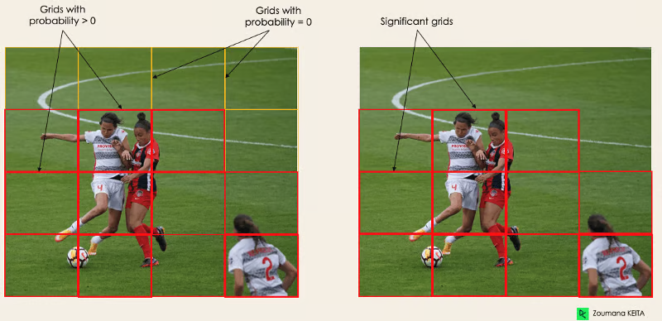
What yolo does after upload
1. Model Initialization
model = YOLO("yolov8n.pt")
person_class_id = 0
confidence_threshold = 0.4
iou_threshold = 0.7
1. Residual blocks
2. Prediction and Filtering
results = model.predict(
source=frame,
classes=[person_class_id],
conf=confidence_threshold,
iou=iou_threshold,
stream=False,
verbose=False
)
2. Bounding box regression

Slide 19
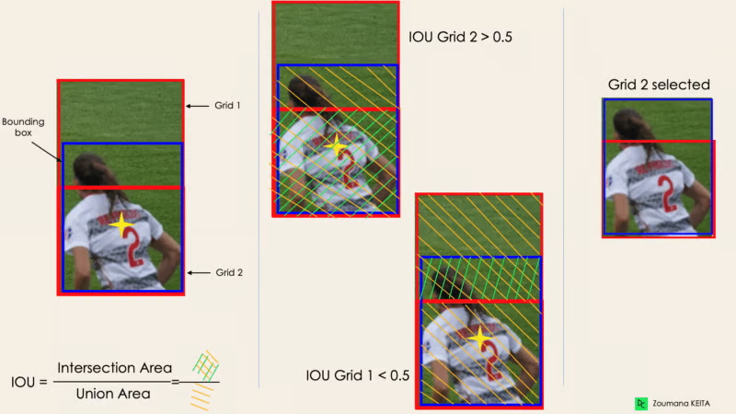
3. Intersection Over Unions or IOU

Slide 20
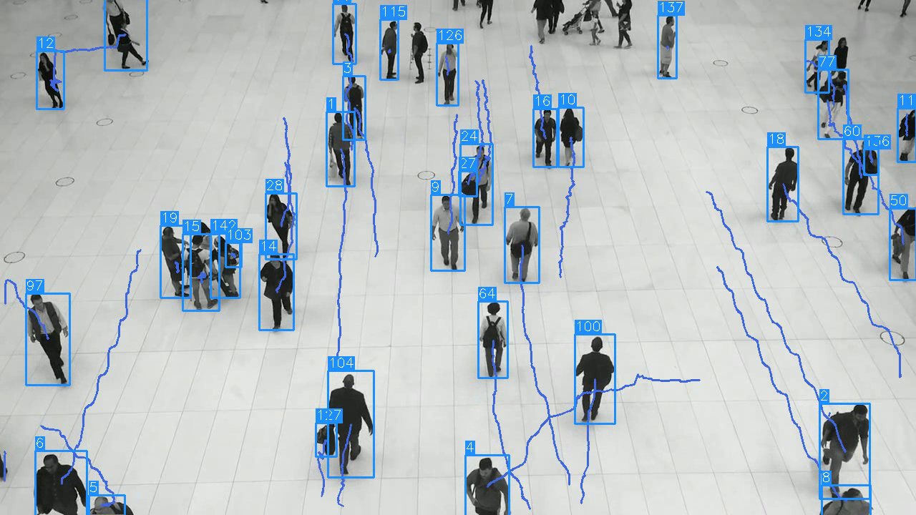
Object Tracking
Object Tracking is a critical function that acts as the bridge between object detection and accurate counting. Since the YOLO model detects people independently in every new video frame, we need a mechanism to confirm that a detection in Frame N is the same person who was detected in Frame N-1.
What it does in backend to detect
1.Proximity Matching
dist = np.sqrt((center_x - prev_x)**2 + (center_y - prev_y)**2)
-> detection is matched only if the minimum distance (min_dist) found is less than 100 pixels.
Matching Threshold
  if dist < min_dist and dist < 100:
  min_dist = dist
  match_id = obj_id # Match found

Slide 21
Counting Logic
The counting logic in the system is directly tied to the Area of Interest (AOI) check within the object tracking loop. It determines if a currently tracked person is positioned in the specific region designated for counting.
1. Counting Point
if line_coords and is_in_aoi_below_line(center_x, center_y, line_coords):
live_count_in_aoi += 1
is_inside = True # Mark the object's status
color = (0, 255, 0) # Draw the box in green (example color)
else:
is_inside = False
color = (255, 0, 255) # Draw the box in magenta (example color)
Formula: It checks if the object's vertical position (Cy) is mathematically located on the "below" side of the line defined by the formula y = mx + b.

